Slide 1


Tech Unveiled: A Deep Dive into TIC and Related Tools
Ayache Khalil 232331413819
LAKRI ABDELDJALIL MOHAMED REDA 232331551104
Alliche Youcef Ali 232331698707
Hamidi mohamed 232331531212
Bekdouche Mechaal Abderrahmane 232331531102
Section:C
Groupe 02

Slide 2

Sommaire
Introduction
Convergence of Technologies
Social Impact of ICT
Key Tools for Harnessing ICT
Transformational Aspects of ICT
Challenges and Considerations in the ICT Landscape
Related Services and Platforms
1
2
3
4
5
6
7
8
Conclusion

Slide 3
1
Introduction
TIC, a broader term than IT, encompasses internet, wireless networks, cell phones, computers, software, middleware, video conferencing, social networking, and other digital media services. These technologies enable users to access, retrieve, store, transmit, and manipulate information digitally, revolutionizing how information is handled across various sectors globally

Slide 4
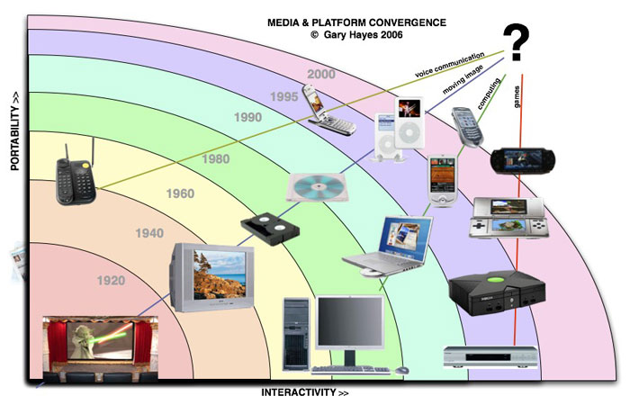
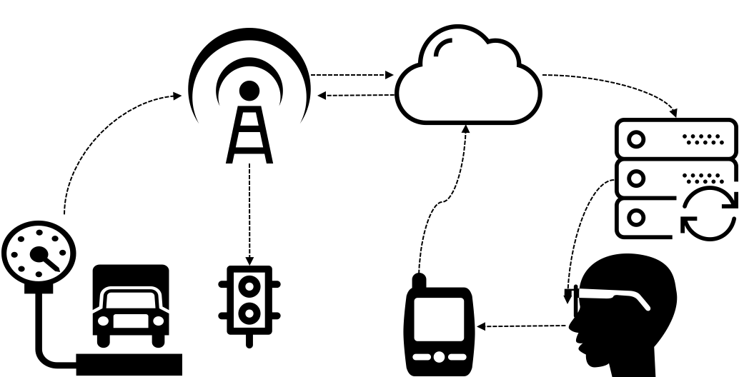
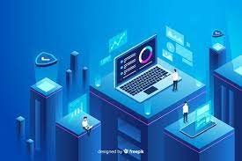
2
Convergence of Technologies
TIC, or Information and Communication Technologies, involves merging audiovisual and telephone networks with computer systems for a unified cabling and management structure. This convergence offers economic advantages. TIC encompasses diverse communication devices like radios, TVs, cell phones, and computers, along with associated services like video conferencing. It spans both digital and analog technologies for various communication modes.

Slide 5

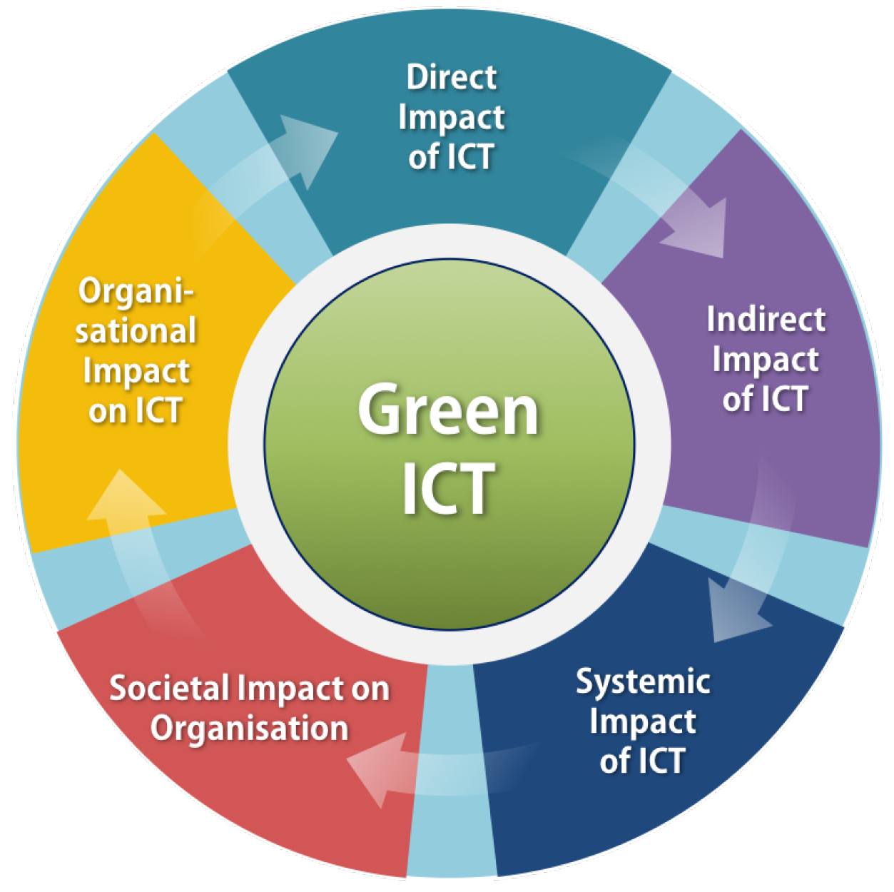
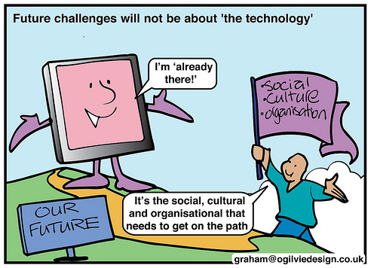
3
Social Impact of ICT
Global Connectivity: Facilitating real-time global communication.
Access to Information: Democratizing information access and knowledge. Economic Opportunities: Creating new job sectors and transforming traditional industries.
Healthcare Advancements: Enabling remote healthcare services and efficient management.
Social Change: Empowering activism and fostering civic engagement.
Cultural Impact: Transforming media consumption and encouraging cross-cultural exchange.
Challenges & Inequalities: Addressing digital divides and privacy concerns.

Slide 6
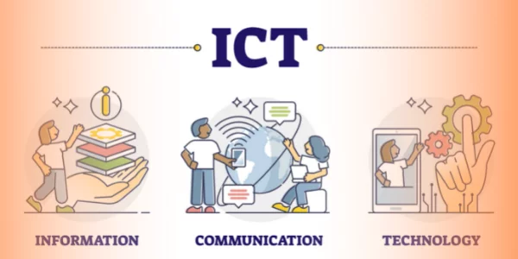
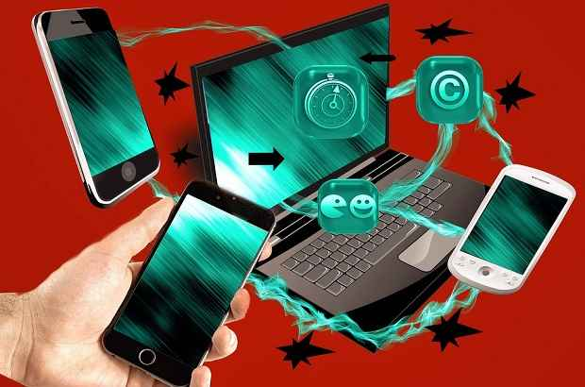
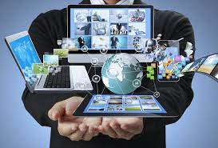
4
Key Tools for Harnessing ICT
.
Search Engines: Google and Yahoo as gateways to vast information repositories.
Social Media Platforms: Facilitating user-generated content, interaction, and connectivity.
Collaboration Tools: Utilizing Git & GitHub for efficient version control and teamwork.

Slide 7


5
Transformational Aspects of ICT
Communication and Connectivity: Redefining how individuals and organizations interact.
Economic Impact: Creating job opportunities and reshaping business models.
Healthcare Innovations: Revolutionizing patient care through telemedicine and health information systems.
Social Change: Empowering activism, advocacy, and civic engagement.
Cultural Exchange: Fostering a global exchange of ideas and values.
.

Slide 8


6
Challenges and Considerations in the ICT Landscape
.
Digital Divide: Addressing disparities in access to ICT resources.
Privacy Concerns: Balancing increased connectivity with the need for data security.
Workforce Changes: Embracing remote work and adapting to automation.
Education and Skill Development: Meeting the demand for digital literacy in the workforce.

Slide 9


7
Related Services and Platforms
.
Google Services: Chrome, Maps, and Gmail as integral components of digital life.
Social Networking Sites: Platforms like Facebook and LinkedIn shaping online social interactions.
Microblogging and Multimedia-Sharing Platforms: Twitter, Tumblr, Instagram, and YouTube redefining content creation and consumption.
Discussion Forums: Platforms like Reddit fostering community-driven discussions.

Slide 10
8
Conclusion
.
Summary: ICTs play a transformative role in reshaping communication, connectivity, and societal dynamics.
Closing Thoughts: The continuous evolution of ICT offers both opportunities and challenges, and understanding its multifaceted impact is essential for navigating the digital era successfully.

Slide 11

Thank you for your attention

